Slide 1

Blockchain Project Work
Presented to: Stefano Ferretti Presented By: Jyoti Yadav Academic Year: 2021-2022

Slide 2
Cryptocurrency
It is a virtual or digital currency used in financial systems. It is secured by cryptography that makes it impossible to be counterfeited or double-spent.
It is not issued from a central authority or central banks, and it is decentralized virtual currencies that can be converted via cryptographic procedures and this make it distinguishable from traditional currencies.
It is created by technology called blockchain, which aims to store data that makes it difficult or impossible to alter, hack, or defraud the system
Notes:
It is secured by cryptography that makes it impossible to be counterfeited or double-spent.

Slide 3
Bitcoin
First cryptocurrency
A distributed, decentralized digital currency system
Released by Satoshi Nakamoto 2008
Effectively a bank run by an ad hoc network
–Digital checks
–A distributed transaction log

Slide 4
Security in Bitcoin
• Authentication -> a Public Key Crypto: Digital Signatures
- Am I paying the right person? Not some other impersonator?
• Integrity -> a Digital Signatures and Cryptographic Hash
- Is the coin double-spent?
- Can an attacker reverse or change transactions?
•Availability -> Broadcast messages to the P2P network
- Can I make a transaction anytime I want?
•Confidentiality -> Pseudonymity
- Are my transactions private? Anonymous?

Slide 5
Problem statement
Cryptocurrencies prices are difficult to forecast due to price volatility and dynamism.
The main objective of this task is to predict the future price of Bitcoin.
How can machine learning algorithms help investors and decision makers to predict Bitcoin prices? and What is the best model for predicting future Bitcoin prices?.
Here I will be comparing three models to determine their efficacy at predicting the price of Bitcoin.

Slide 6
Dataset
The Dataset has been gathered from the yahoo finance. from 2014-2021, with the updates of OHLC (Open, High, Low, Close, Volume) in BTC and indicated currency.
Date: timestamp
Open: Opening price on the given day
High: Highest price on the given day
Low: Lowest price on the given day
Close: Closing price on the given day
Volume: Volume of transactions on the given day

Slide 7
Web Scrapping
Web Scraping is an automatic way to retrieve unstructured data from a website and store them in a structured format.
To make the prediction on the best performing model. The 10 days of Historical data has been scrapped from yahoo finance using Data using Selenium and Beautiful Soup in Python
Notes:
There are mainly two ways to extract data from a website:
Use the API of the website (if it exists). For example, Facebook has the Facebook Graph API which allows retrieval of data posted on Facebook.
Access the HTML of the webpage and extract useful information/data from it. This technique is called web scraping or web harvesting or web data extraction.
Steps involved in web scraping:
Send an HTTP request to the URL of the webpage you want to access. The server responds to the request by returning the HTML content of the webpage. For this task, we will use a third-party HTTP library for python-requests.
Once we have accessed the HTML content, we are left with the task of parsing the data. Since most of the HTML data is nested, we cannot extract data simply through string processing. One needs a parser which can create a nested/tree structure of the HTML data. There are many HTML parser libraries available but the most advanced one is html5lib.
Now, all we need to do is navigating and searching the parse tree that we created, i.e. tree traversal. For this task, we will be using another third-party python library, Beautiful Soup. It is a Python library for pulling data out of HTML and XML files.
Selenium is a Python library and tool used for automating web browsers to do a number of tasks. One of such is web-scraping to extract useful data and information that may be otherwise unavailable

Slide 8
Workflow
Import libraries
Data Analysis
Main features
Normalizing
Train Test Split
Model Building
Evaluation metrics
Summary
Forecasting
Future Work

Slide 9
Data Analysis
Shape of the dataset - (2707, 7)
Drop the unwanted columns
Impute missing values using interpolation
Convert the date column to date format

Slide 10
Main Features
Features – Open, High, Low, Volume
Target - shifted our outcome variable up (-1) by one timestep. The purpose is to organize our data such that the predictor variables will be used to predict the following days closing price, Tomorrow_close.

Slide 11
Normalizing the dataset
Feature scaling is the process of normalizing the range of features in a dataset.
Real-world datasets often contain features that are varying in degrees of magnitude, range and units.
In machine learning models to interpret these features on the same scale, we need to perform feature scaling.
Since the default activation function for these models is the hyperbolic tangent (tanh) function, which outputs a range from -1 to 1, I scaled values to fit this range. Hence we used MinMaxScaler
MinMaxScaler has managed to rescale those features so that their values are bounded between 0 and 1.

Slide 12
3 guidelines
First, we fit the scaler to the training set using the fit() function
Next, we apply the scale to the training set using the transform() function
Finally, you apply the scale to the test set

Slide 13
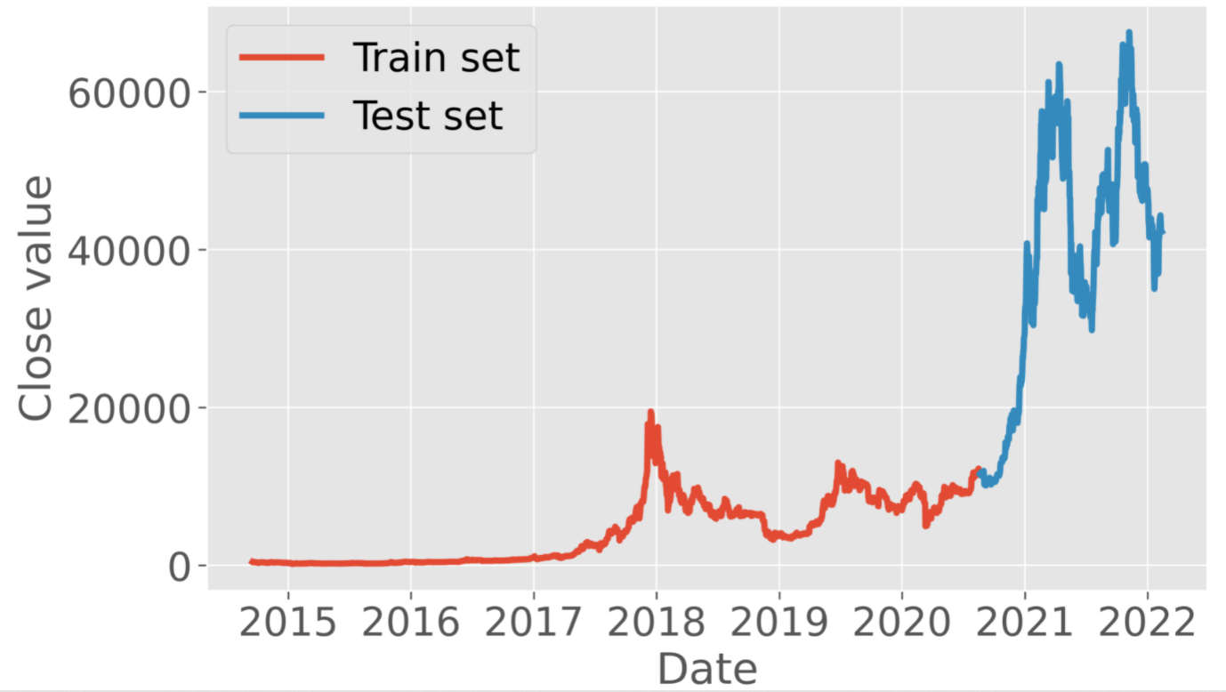
Train test split
Data is ready to split into a training set and a test set. I chose an 80/20 split for training and test data.

Slide 14
Model Building
Recurrent neural networks (RNNs) have their capacity to deal with sequential data, making them valuable tools to explore tasks involving text, audio, images, videos, and financial markets.
RNN suffers from the problem of vanishing gradient
RNN suffers from short-term memory
To overcome this problem, specialized RNNs were developed.
Bidirectional LSTM (BiLSTM)
Long short-term memory units (LSTM)
Gated recurrent units (GRU).
Notes:
Recurrent Neural Networks suffer from short-term memory. If a sequence is long enough, they’ll have a hard time carrying information from earlier time steps to later ones. So if you are trying to process a paragraph of text to do predictions, RNN’s may leave out important information from the beginning.
During back propagation, recurrent neural networks suffer from the vanishing gradient problem. Gradients are values used to update a neural networks weights. The vanishing gradient problem is when the gradient shrinks as it back propagates through time. If a gradient value becomes extremely small, it doesn’t contribute too much learning.
https://towardsdatascience.com/illustrated-guide-to-lstms-and-gru-s-a-step-by-step-explanation-44e9eb85bf21

Slide 15
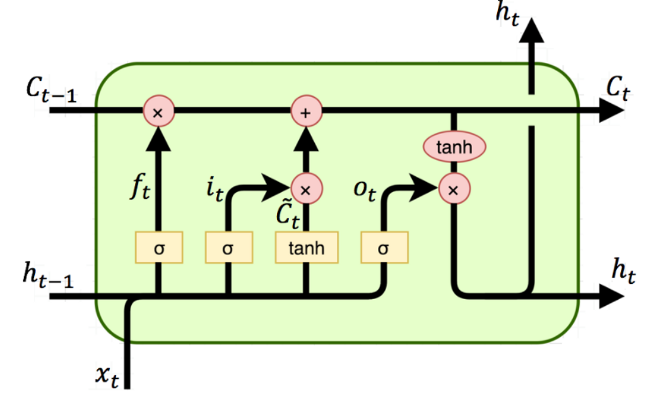
Long short term memory units (LSTM)
Long Short-Term Memory (LSTM) is a specialized RNN to mitigate the gradient vanishing problem.
LSTMs can learn long-term dependencies using a mechanism called gates.
These gates can learn what information in the sequence is important to keep or throw away.
LSTMs have three gates;
input,
Forget
output.

Slide 16
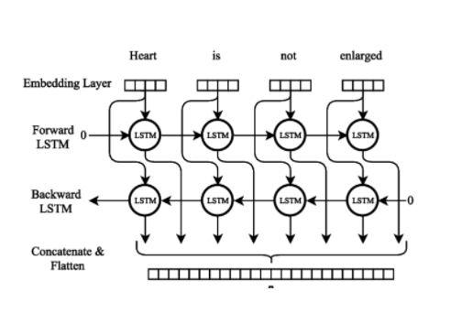
bidirectional LSTM (BiLSTM)
The idea of Bidirectional LSTMs (BiSTM) is to aggregate input information in the past and future of a specific time step in LSTM models.
In BiLSTM, at any point in time, you are able to preserve information from both past and future.

Slide 17
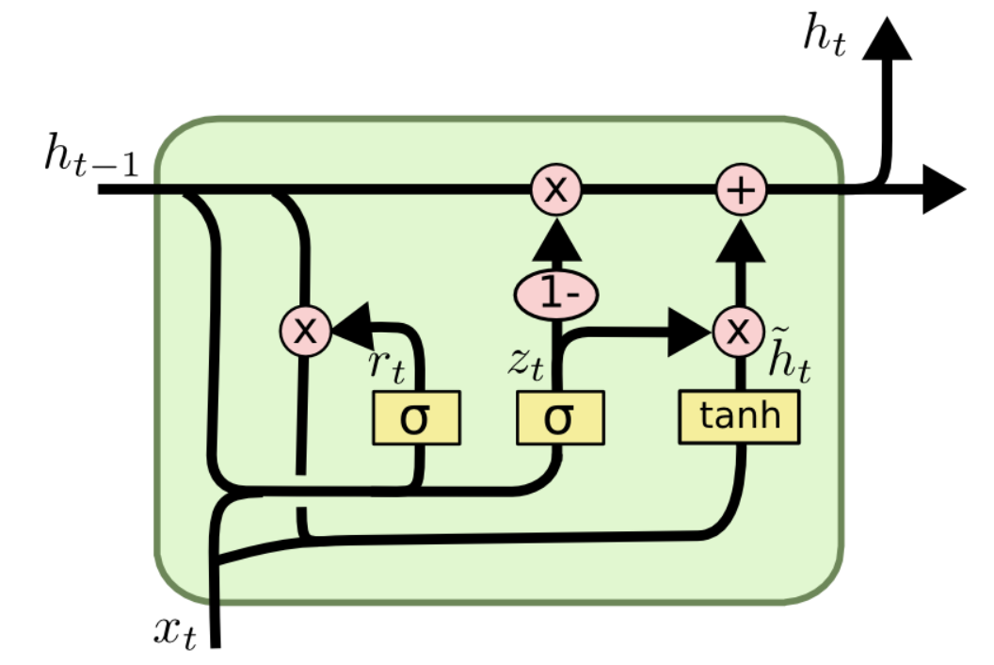
Gated Recurrent Unit (GRU)
Gated Recurrent Unit Gated Recurrent Unit (GRU) is a new generation of Neural Networks and is pretty similar to LSTM.
GRU gets rid of the cell state and uses a hidden state to transfer information.
The other difference between GRU and LSTM is that GRU has only two gates; reset and update gate.

Slide 18
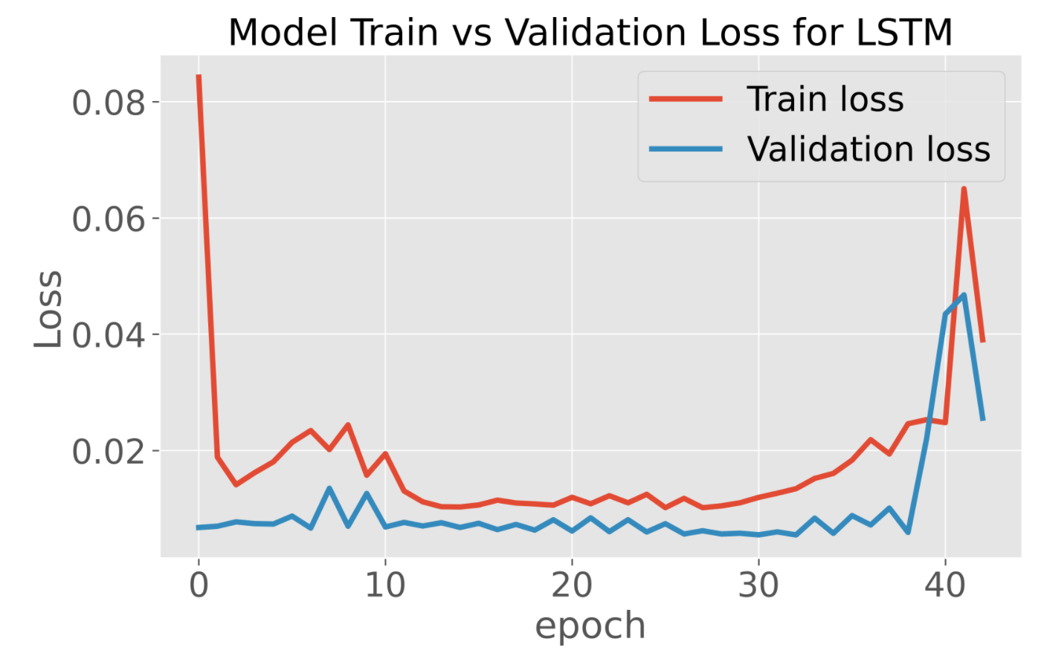

Slide 19
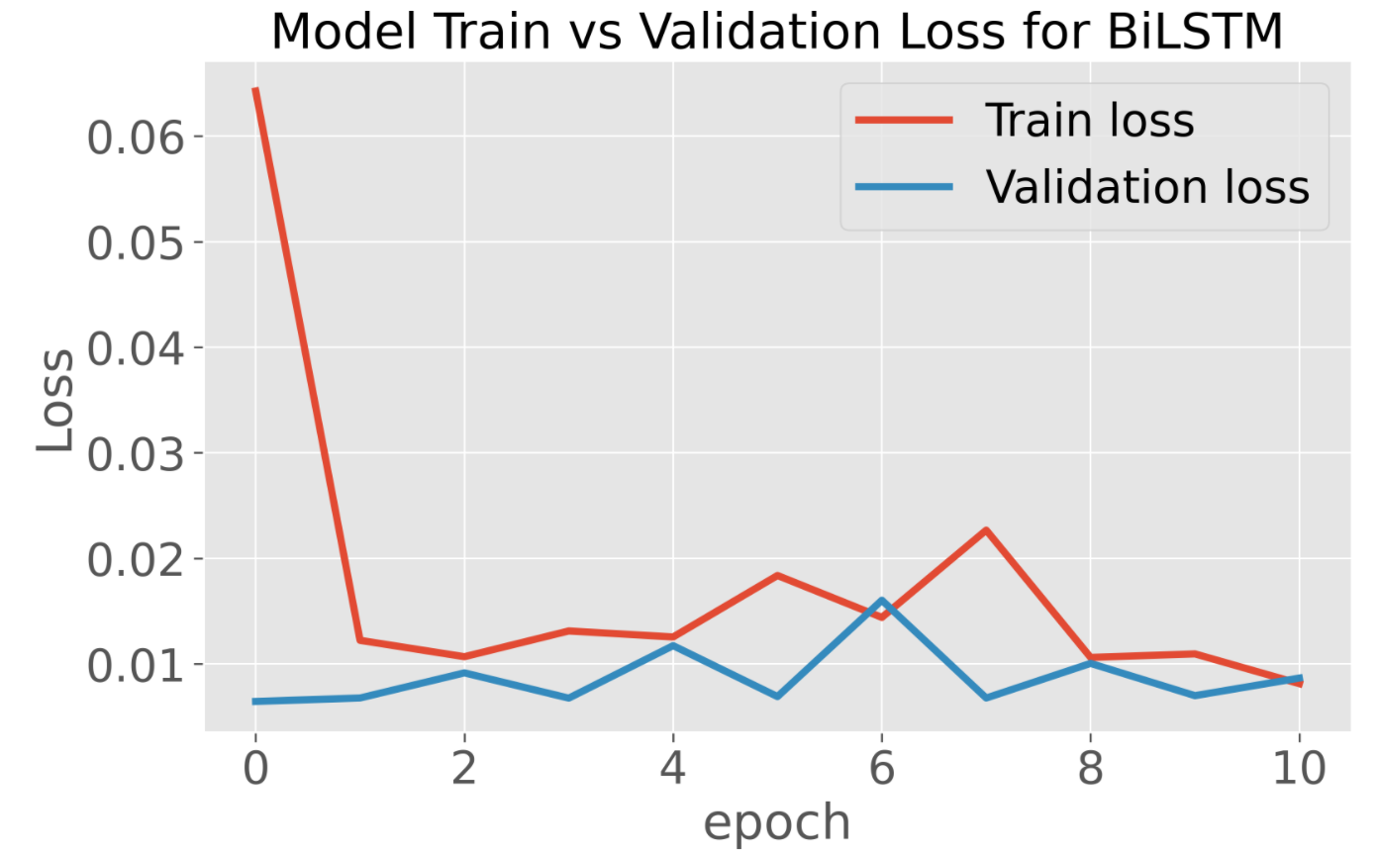
Evaluation Metrics

Slide 20
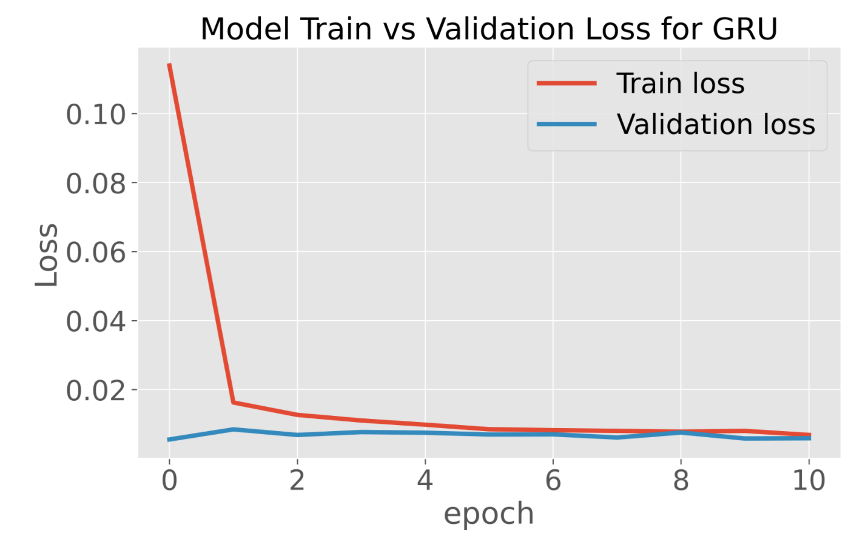

Slide 21
Predictions
As we can see, when inspected visually both the predicted values from the LSTM and BiLSTM follow the test data remarkably well until the sharp rise in values toward the end of the data set.
On the other hand, the GRU model appears to have the best overall fit. Even if it doesn’t tightly follow the true data, it seems to be better at following the trends present in the data.

Slide 22
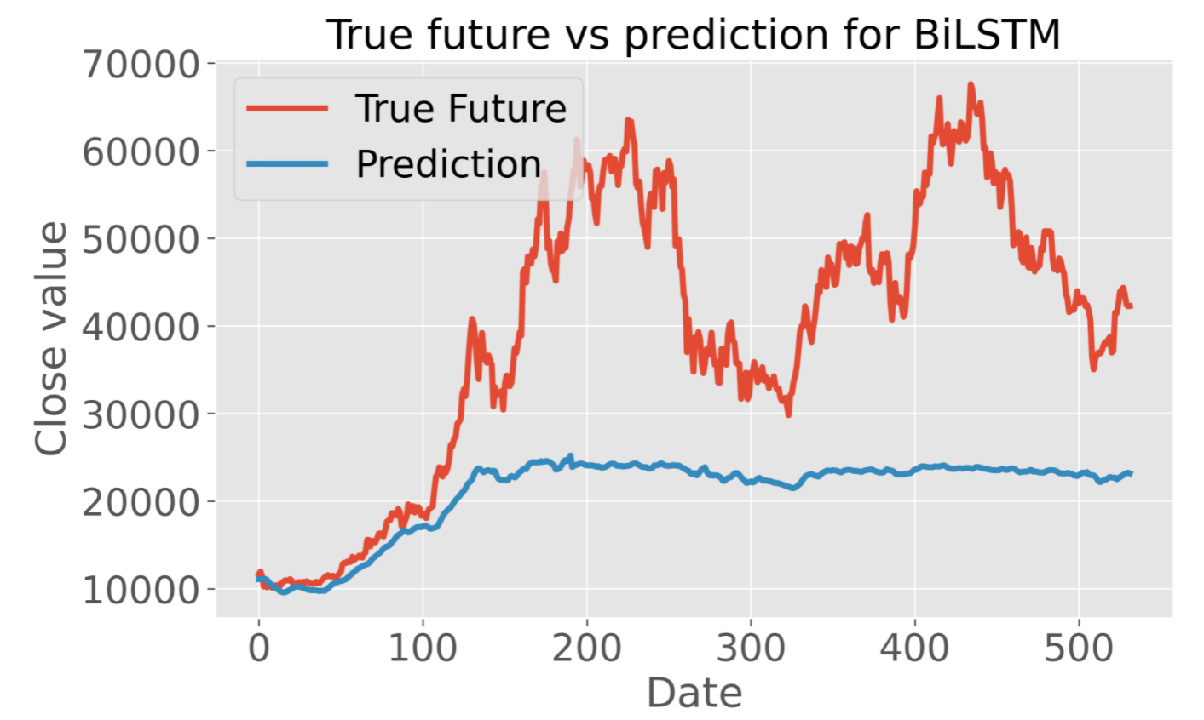
Prediction plot for BiLSTM

Slide 23
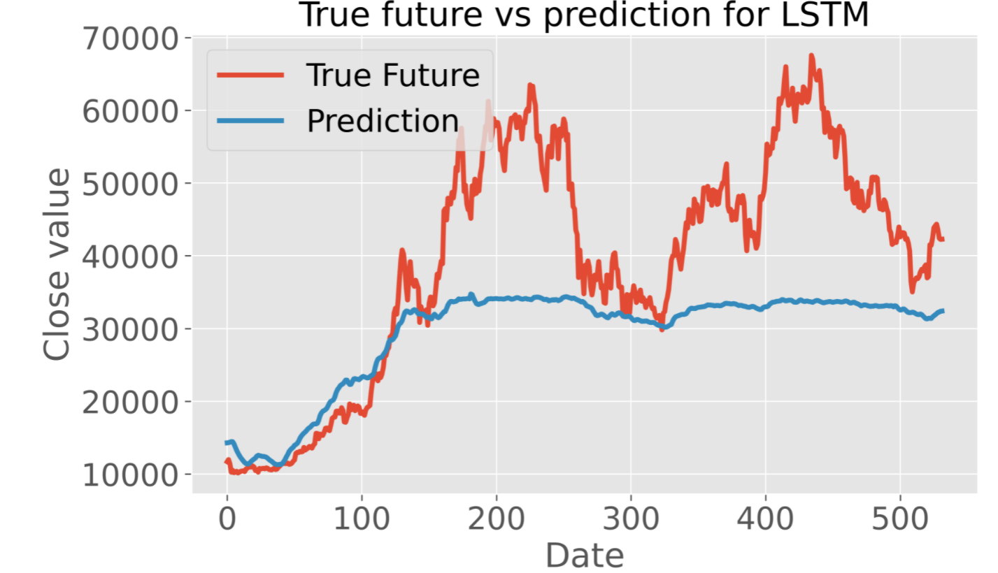
Prediction plot for LSTM

Slide 24
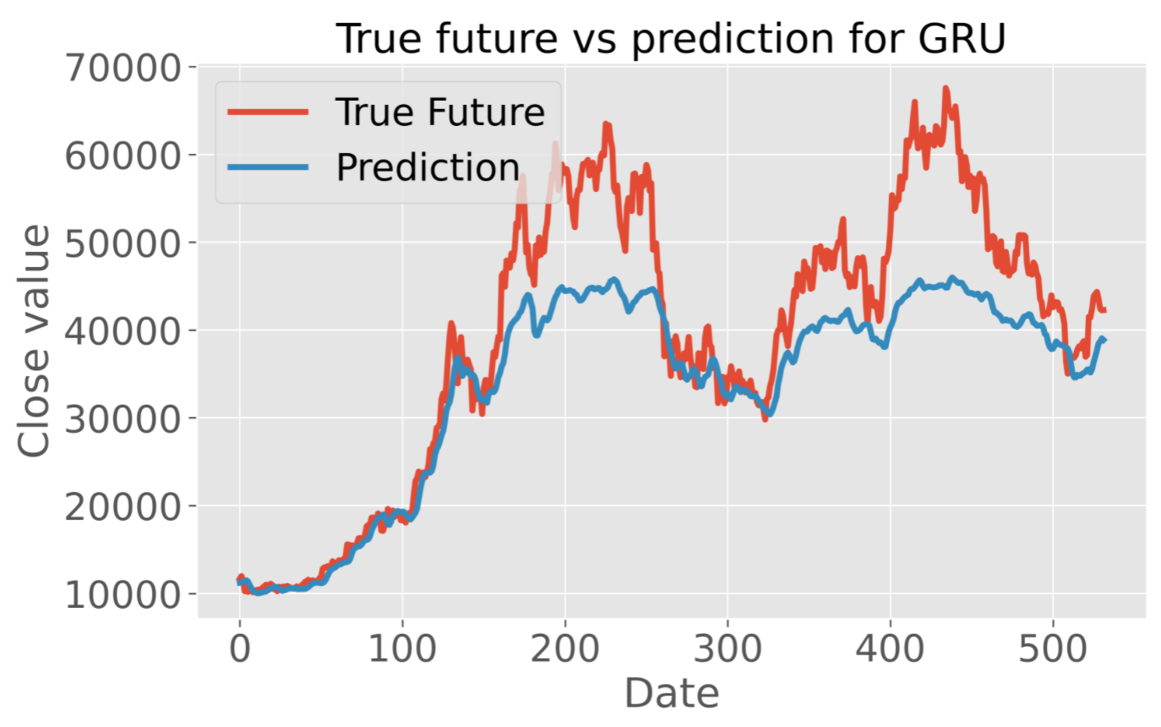
Prediction plot for GRU

Slide 25
Quantitative metrics
BiLSTM: Mean Absolute Error: 18625.8182 Root Mean Square Error: 22103.2695 LSTM: Mean Absolute Error: 17478.5699 Root Mean Square Error: 21031.1680 GRU: Mean Absolute Error: 6289.9744 Root Mean Square Error: 8297.7980

Slide 26
Summary
The goal is to predict the upward or downward trend rather than prediction value
With that in mind, I feel that the GRU model performed better.

Slide 27
Forecasting
GRU model to forecast future prices.
January 19
Predicted: 36586.61
Actual: 40122.16
January 20
Predicted: 36888.023
Actual: 38431.38
January 21
Predicted: 37487.41
Actual: 38075.28

Slide 28
Conclusion
I tested the efficacy of LSTM, BiLSTM, and GRU models on predicting Bitcoin prices.
After training the models, they were each put to the test. Each performed rather well, but the GRU model was found to be a better indicator of trend, which I felt would be more relevant from a trading perspective.
When the GRU model was used to forecast values, it performed quite well. Although the prices were not predicted exactly, the trend was on point!

Slide 29
Future work
Bitcoin is affected by external influences such as news, social media. Performing Sentimental analysis on bitcoin can certainly improve the performance of the model.

Slide 30
References
A Novel Cryptocurrency Price Prediction Model Using GRU, LSTM and bi-LSTM Machine Learning Algorithms
Bitcoin Price Prediction and Analysis Using Deep learning Models
Bitcoin Price Prediction Using Machine Learning Algorithms
Bitcoin price prediction using machine learning
Predicting price of cryptocurrency of a deep learning approch
Bitcoin Price prediction Based on Deep learning Methods

Slide 31


